Slide 1
The Complete Front-End Development course
Asynchronous JS, JSON and XML

Slide 2
Module 11
Serving and retrieving data to a web site
Synchronous vs Asynchronous loading
Set up and handle AJAX requests and responses.
JSON
XML
Processing JSON data
JSON vs. XML

Slide 3
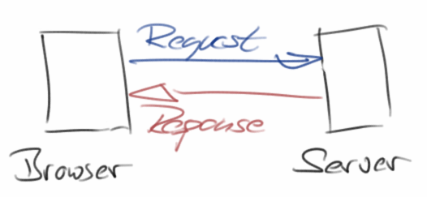
Request and Response
The Hypertext Transfer Protocol (HTTP) is designed to enable communications between clients and servers
HTTP works as a request-response protocol between a client and server

Slide 4
Synchronous vs Asynchronous
Two types of requests- synchronous and asynchronous
Synchronous- one instruction at a time
Asynchronous- execution is done in a separate thread or process
JavaScript is a synchronous language.
A browser is made up of- JavaScript Engine, Event Queue, HTML Rendering, webGL, HTTP Requestor.
JavaScript engine is synchronous, but HTTP Requestor is asynchronous.
Notes:
There are two types of requests synchronous as well as asynchronous. Synchronous requests are the one which follows sequentially i.e. if one process is going on and at the same time another process wants to be executed, it will not be allowed that means the only one process at a time will be executed. This is not good because in this type most of the time CPU remains idle such as during I/O operation in the process which are the order of magnitude slower than the CPU processing the instructions. Thus to make the full utilization of the CPU and other resources use asynchronous calls.
https://developer.mozilla.org/en-US/docs/Learn/JavaScript/Asynchronous/Concepts

Slide 5
Advantages of Asynchronous
Speed is enhanced as there is no need to reload the page again.
Making asynchronous calls to a web server - client browsers avoid waiting for all the data to arrive before starting of rendering.
Form validation can be done in real-time with it.

Slide 6
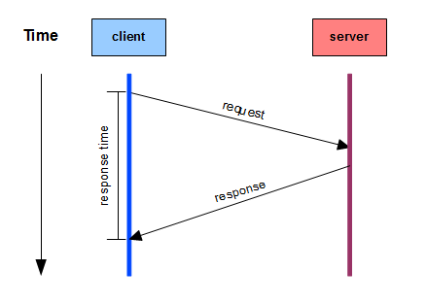
Asynchronous
Multitasking
To make full utilization of the CPU and other resources use asynchronous calls.
Notes:
https://developer.mozilla.org/en-US/docs/Learn/JavaScript/Asynchronous/Introducing

Slide 7
Timeouts and intervals
Traditional methods JavaScript has available for running code asynchronously
After a set time period has elapsed, or at a regular interval do the task
Cooperative asynchronous JavaScript
setTimeout(), setInterval()
Notes:
https://developer.mozilla.org/en-US/docs/Learn/JavaScript/Asynchronous/Timeouts_and_intervals

Slide 8
Get and Post
The two methods to request data from server-
Get and Post
GET /index.html?name=SkillLync http/1.1
Method, URI string, Query string, http version
HTTP response status
200, OK
404, Not found
403, Forbidden
500, Internal Server Error
Notes:
For a complete list go to the Http Messages Reference

Slide 9
Get vs Post
The GET method may return cached data.
GET requests should never be used when dealing with sensitive data as it passes it in the query string
GET requests have length restrictions
The POST method never caches data.
POST requests sends data without any length restrictions
POST is used for working with sensitive data.

Slide 10
AJAX
Reads data from a web server - after the page has loaded
Updates a web page without reloading the page
Sends data to a web server in the background
AJAX uses a combination of:
A browser built-in XMLHttpRequest object (to request data from a web server)
JavaScript and HTML DOM (to display or use the data)

Slide 11
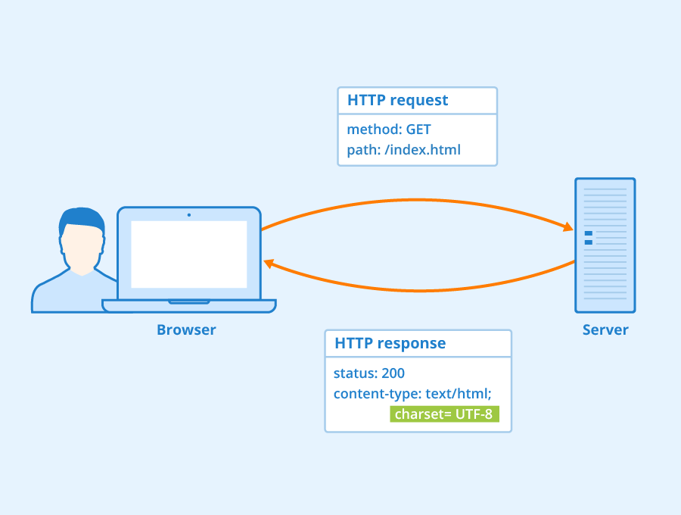
The AJAX code

Slide 12
XMLHttpRequest object
All modern browsers support the XMLHttpRequest object.
The XMLHttpRequest object can be used to exchange data with a web server behind the scenes.
This object has properties and methods.

Slide 13
XMLHttpRequest Object Methods
new XMLHttpRequest()- Creates a new XMLHttpRequest object
abort()- Cancels the current request
getAllResponseHeaders()- Returns header information
getResponseHeader()- Returns specific header information
open(method, url, async, user, psw)- Specifies the request
method: the request type GET or POST url: the file location async: true (asynchronous) or false (synchronous) user: optional user name psw: optional passwords

Slide 14
XMLHttpRequest Object Properties
Onreadystatechange- Defines a function to be called when the readyState property changes
readyState- Holds the status of the XMLHttpRequest.
0: request not initialized 1: server connection established 2: request received 3: processing request 4: request finished and response is ready
responseText- Returns the response data as a string
Status- Returns the status-number of a request

Slide 15
The AJAX process
JavaScript code and HTTP Requestor work together independently
The HTTP requestor is given address of the JavaScript function response handler- callback function.
If in AJAX, we use the code differently, then requests and responses can get mixed and a race condition might get developed.
Hence mind the sequence!
Notes:
Network tab- observe all requests. So much JS
https://developer.mozilla.org/en-US/docs/Learn/JavaScript/Asynchronous Do this whole
https://developer.mozilla.org/en-US/docs/Web/HTTP/Status
function loadDoc() { var xhttp = new XMLHttpRequest(); xhttp.onreadystatechange = function() { if (this.readyState == 4 && this.status == 200) { document.getElementById("demo").innerHTML = this.responseText; } }; xhttp.open("GET", "ajax_info.txt", true); xhttp.send(); }

Slide 16
Request
Event triggered at change in readyState
xhttp.onreadystatechange = function () {
if (this.readyState == 4 && this.status == 200) {
document.getElementById(“test").innerHTML = this.responseText;
}
};
xhttp.open("GET", "ajax_info.txt", true);
xhttp.send();
or xhttp.send(“jsonstring”);
If want synchronous, add false as async argument

Slide 17
Response
Adding different callback functions for different AJAX responses so responses are handled separately
Response property- reqobj.responseText
Response methods- getAllResponseHeaders()
this.getAllResponseHeaders() in onreadystatechange function
Notes:
When readyState is 4 and status is 200, the response is ready:
The onreadystatechange event is triggered four times (1-4), one time for each change in the readyState.
loadDoc("url-1", myFunction1); loadDoc("url-2", myFunction2); function loadDoc(url, cFunction) { var xhttp; xhttp = new XMLHttpRequest(); xhttp.onreadystatechange = function() { if (this.readyState == 4 && this.status == 200) { cFunction(this); } }; xhttp.open("GET", url, true); xhttp.send(); } function myFunction1(xhttp) { // action goes here } function myFunction2(xhttp) { // action goes here }

Slide 18
jQuery and AJAX
$(selector).load(URL,data,callback);
The callback function can have different parameters:
responseTxt - contains the resulting content if the call succeeds
statusTxt - contains the status of the call
req - contains the XMLHttpRequest object
$.get(URL, callback);
$.get( url [, data ] [, success ] [, dataType ] )
$.post(URL, data, callback);
$.post( url [, data ] [, success ] [, dataType ] )
Notes:
https://api.jquery.com/category/ajax/shorthand-methods/
The required URL parameter specifies the URL you wish to request.
The optional callback parameter is the name of a function to be executed if the request succeeds.
The first callback parameter holds the content of the page requested, and the second callback parameter holds the status of the request.
This is a shorthand Ajax function, which is equivalent to:
$.ajax({
url: url,
data: data,
success: success,
dataType: dataType
});
https://api.jquery.com/jQuery.get/ for example codes
The required URL parameter specifies the URL you wish to request.
The optional data parameter specifies some data to send along with the request.
The optional callback parameter is the name of a function to be executed if the request succeeds.
This is a shorthand Ajax function, which is equivalent to:
$.ajax({
type: "POST",
url: url,
data: data,
success: success,
dataType: dataType
});
https://api.jquery.com/jQuery.post/ for examples
The following example loads the content of the element with id="p1", inside the file "demo_test.txt", into a specific <div> element:
$("#div1").load("demo_test.txt #p1");
The following example displays an alert box after the load() method completes. If the load() method has succeeded, it displays "External content loaded successfully!", and if it fails it displays an error message:
$("button").click(function () {
$("#div1").load("https://jsonplaceholder.typicode.com/users", function (responseTxt, statusTxt, xhr) {
if (statusTxt == "success")
alert("External content loaded successfully!");
if (statusTxt == "error")
alert("Error: " + xhr.status + ": " + xhr.statusText);
});
});

Slide 19
jQuery and AJAX
jQuery.getScript( url [, success ] )
Load a JavaScript file from the server using a GET HTTP request, then execute it.
Notes:
ajax({
url: url,
dataType: "script",
success: success
});
https://api.jquery.com/jQuery.getScript/
This is a shorthand Ajax function, which is equivalent to:
$.ajax({
dataType: "json",
url: url,
data: data,
success: success
});
https://api.jquery.com/jQuery.getJSON/ for examples

Slide 20
Promises
What is a promise?
Promise represents the eventual result of some sort of operation typically an async operation.
States
Pending
fulfilled(resolved)
rejected
Notes:
https://www.freecodecamp.org/news/javascript-es6-promises-for-beginners-resolve-reject-and-chaining-explained/
https://developer.mozilla.org/en-US/docs/Learn/JavaScript/Asynchronous/Promises
Let myPromise = new Promise((resolve, reject){
setTimeout(() => { Resolve (‘Good to go’);}, 1000);
setTimeout(() => { reject (‘uh oh’);}, 500);
});
myPromise.then((res){
console.log(res);
})
.catch((err) => {
Console.log(err);
});
$.when used in JQuery for knowing multiple promises completed.
Let myPromise2= new Promise((resolve, reject) => {
setTimeout(() => {
resolve(‘Promise 2’);
}, 1500);
});
Promise.all([myPromise, myPromise2]).then((data) => {
Console.log(data);
})
.catch((err) => {console.log(err);}); //o/p- uh oh
Fetch API of browser returns promise
Fetch(‘api link’).then((res) => {
Res.json().then((data) => {
Console.log(data);
});
})
.catch((err) => {
Console.log(err);
});

Slide 21
Async await
More recent additions to the JavaScript language
’async’ functions and the ’await’ keyword
Part of ECMAScript 2017 JavaScript edition
Async await exactly same as promises just a simpler syntax.
Makes asynchronous code easier to write and to read afterwards.
Notes:
https://developer.mozilla.org/en-US/docs/Learn/JavaScript/Asynchronous/Async_await

Slide 22
The Fetch API
What is the Fetch API?
Using fetch API to get JSON response from server
Notes:
https://developer.mozilla.org/en-US/docs/Web/API/Fetch_API
https://jsonplaceholder.typicode.com/

Slide 23
Right approach
Choosing the right approach to doing asynchronous programming.
When to use timeouts and intervals?
When to use AJAX?
When to use promises/async await?
Notes:
https://developer.mozilla.org/en-US/docs/Learn/JavaScript/Asynchronous/Choosing_the_right_approach

Slide 24
Data exchange
Data is stored and exchanged in a variety of business applications-
Social media data generation
Ecommerce data generation
Stocks history and financial transactions
Internet of things information exchange
Medical devices and realtime critical applications
Mathematical and Scientific experiment data
News archives and Weather services

Slide 25
Data exchange formats
Pure data storage
No presentation/business logic
Separation of concerns
Format should be such that changing structure shouldn’t break existing presentation/business logic.
And changing presentation/server side logic shouldn’t need a structure change.

Slide 26


JSON
JavaScript Object Notation is a simple text format
Looks like a JavaScript object
Can be converted into one easily for JS processing of server data
No complicated parsing and translations.
Compact as a string, open as a JS object.
Lightweight, language and platform independent
Important for backend programming, NoSQL databases like MongoDB
Notes:
Get data from database in a format to represent in the front end like a table etc
A wire format to translate to different language data structures of nested keys and values. Wire protocol
https://developer.mozilla.org/en-US/docs/Learn/JavaScript/Objects/JSON
Add the JSON viewer ex
https://jsonplaceholder.typicode.com/
JSON stands for JavaScript Object Notation. It is a text-based data interchange format to maintain the structure of the data. JSON is the replacement of the XML data exchange format in JSON. It is easy to struct the data compare to XML. It supports data structures like array and objects and the JSON documents that are rapidly executed on the server. It is also a Language-Independent format which is derived from the JavaScript. The official media type for the JSON is application/json and to save those file .json extension.

Slide 27
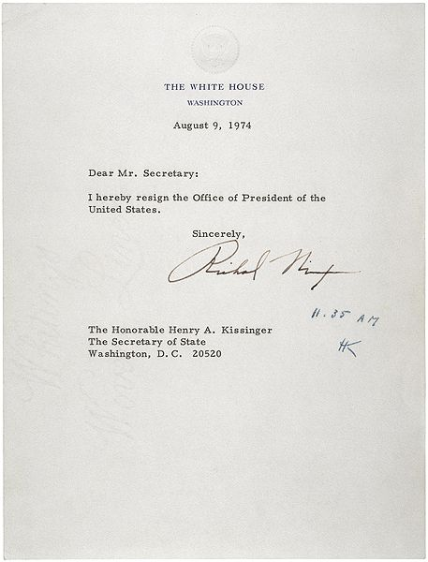

Slide 28
Advantages of JSON
Its syntax is very easy to use
Its syntax is very small and light-weighted that’s the reason that it executes and responds in a faster way
JSON has a wide range for the browser support compatibility with the operating systems
It doesn’t require much effort to make it all browser compatible
On the server-side parsing is very fast with JSON
If the parsing is fast on the server side then the user can get the fast response

Slide 29
Disadvantages of JSON
There is no error handling in JSON, if there be a slight mistake in the JSON script then you will not get the structured data
So need to verify JSON before use always

Slide 30
Data types
In JSON, values must be one of the following data types:
a string
a number
an object (JSON object)
an array
a boolean
null
JSON values cannot be one of the following data types:
a function
a date
undefined

Slide 31
Sending JSON
Convert for JS object to JSON string.
JSON.stringify() accommodates everything except functions
Send it as data over a function call or async call.
Can use JSON string with other string to get the desired data.
jQuery.getJSON( url [, data ] [, success ] )
Load JSON-encoded data from the server using a GET HTTP request.
Notes:
var myObj = {name: "John", age: 31, city: "New York"}; var myJSON = JSON.stringify(myObj); window.location = "demo_json.
var obj = { name: "John", age: function () {return 30;}, city: "New York" }; obj.age = obj.age.toString(); var myJSON = JSON.stringify(obj); document.getElementById("demo").innerHTML = myJSON;
php?x=" + myJSON;

Slide 32
Receiving JSON
Obtain JSON string then convert to JS object
JSON.parse(JSONdata);
Use this as data to iterate over and display in HTML page e.g. as a table.
Can use JSON string with other string to get the desired data to display.
Notes:
var myJSON = '{"name":"John", "age":31, "city":"New York"}'; var myObj = JSON.parse(myJSON); document.getElementById("demo").innerHTML = myObj.name;

Slide 33
Storing JSON
Just like storing a text but in a better format to use it easily next time
The file type for JSON files is ".json"
The MIME type for JSON text is "application/json"
Notes:
// Storing data: myObj = {name: "John", age: 31, city: "New York"}; myJSON = JSON.stringify(myObj); localStorage.setItem("testJSON", myJSON); // Retrieving data: text = localStorage.getItem("testJSON"); obj = JSON.parse(text); document.getElementById("demo").innerHTML = obj.name;

Slide 34
Serialisation
Serialise – encode to JSON from server side script
De Serialise – parse from JSON at client side script
What is serialize() in jQuery?
In the standard URL- encoded notation jQuery serialize() is used to create the text strings.
$("button").click(function(){ $("div").text($("form").serialize()); });
Notes:
Use https://jsonplaceholder.typicode.com/ for all examples

Slide 35
Traversing JSON
Most programming languages have great libraries to parse and generate JSON data e.g. JSONB in Java
The same way JavaScript objects can be used as JSON, JavaScript arrays can also be used as JSON.
Two ways to parse JSON-
Object parsing syntax
Associative arrays syntax
Parsing a non JSON object eg date, function
Notes:
var text = '{ "name":"John", "birth":"1986-12-14", "city":"New York"}'; var obj = JSON.parse(text, function (key, value) { if (key == "birth") { return new Date(value); } else { return value; } });
var text = '{ "name":"John", "age":"function () {return 30;}", "city":"New York"}'; var obj = JSON.parse(text); obj.age = eval("(" + obj.age + ")"); document.getElementById("demo").innerHTML = obj.name + ", " + obj.age();
You should avoid using functions in JSON, the functions will lose their scope, and you would have to use eval() to convert them back into functions.

Slide 36
The for in loop
Loop though JSON keys and values
Loop through JSON arrays
Nested JSON objects and arrays
Notes:
myObj = { "name":"John", "age":30, "car":null }; for (x in myObj) { document.getElementById("demo").innerHTML += x;
document.getElementById("demo").innerHTML += myObj[x]; }
for (i in myObj.cars) { x += myObj.cars[i]; }
for (i = 0; i < myObj.cars.length; i++) { x += myObj.cars[i]; }

Slide 37
Other JSON manipulations
Adding JSON attributes
Deleting JSON attributes
Check if a key exists in JSON
Notes:
delete myObj.cars.car2;

Slide 38
Same-origin security feature
Browsers use same source, same origin rule. They do not allow access across domains.
Other sources are not allowed to be accessed by the website
We need CORS to tell browser what sources are safe.
Cross-origin resource sharing (CORS)- mechanism that allows resources on a web page to be requested from an outside domain
This domain is other than the one from which the first resource was served.
A web page may then freely embed cross-origin images, stylesheets, scripts, iframes, and videos.

Slide 39
XML
eXtensible Markup Language
XML Does Not Use Predefined Tags
Element- attribute- content
<mydefinition>
This is the structure I define. Mah life, mah rulez!
<firstpart>
<description>This is the first part</description>
</firstpart>
<secondpart>
<description>This is the second part</description>
</secondpart>
<thirdpart>
<banana>This is my wish, I create whatever I want to.</banana>
</thirdpart>
</mydefinition>

Slide 40
XML
XML- structure data vs HTML- display data
New rules or tags can be added in your xml later
Great to share understandable data-
<thisismostimp>First wish</thisis mostimp>
<thisisprioritytwo>Second wish</thisisprioritytwo>
So on…
Stores and shares as text so we don’t lose data due to conversions in different formats
Notes:
The other person will know exactly what this data means and you can program the rules in your script too to fulfil first wish first then go to second wish etc.

Slide 41
Rules for XML
Should have root tag always
Should have closing tag always
Proper nesting is important to validate XML
Attributes in quotes
<mywish priority=“first”></mywish>
Comments
<!-- This is a comment -->
Notes:
https://codebeautify.org/xmlvalidator
<!-- This is a comment -->

Slide 42
Rules for XML
Element names
are case-sensitive
must start with a letter or underscore
cannot start with the letters xml (or XML, or Xml, etc)
can contain letters, digits, hyphens, underscores, and periods
cannot contain spaces

Slide 43
Traversing XML
XML is a tree structure
Nodes
Parent
Children
Siblings
element node
attribute node
text node
Properties- nodeName , nodeType
All major browsers have a built-in XML parser to access and manipulate XML.
Notes:
var xhttp = new XMLHttpRequest(); xhttp.onreadystatechange = function() { if (this.readyState == 4 && this.status == 200) { myFunction(this); } }; xhttp.open("GET", "books.xml", true); xhttp.send(); function myFunction(xml) { var xmlDoc = xml.responseXML; document.getElementById("demo").innerHTML = xmlDoc.getElementsByTagName("title")[0].childNodes[0].nodeValue; }
;

Slide 44
Manipulating XML
Get XML elements
Send XML elements
Change XML elements
Add XML elements
Delete XML elements
Notes:
https://docs.microsoft.com/en-us/previous-versions/windows/desktop/ms762271(v=vs.85)
getElementsByTagName()
getAttribute()
childNodes
nodeValue

Slide 45
JSON vs XML
XML has to be parsed with an XML parser
JSON can be parsed by a standard JavaScript function
JSON can use arrays, XML cannot

Slide 46
Best practices
Use attributes in XML as less as possible.
Create them as elements instead, to include multiple, nested and expandable data.
Always validate json/XML

Slide 47
Summary
Requesting from browser
Asynchronous request and responses
Various methods of asynchronous calls
Data exchange formats- JSON and XML for communication with server
Bonus knowledge- Fetch API, Same origin security feature.

Slide 48
Motivational tip
Build projects that will get you hired.
Showcase your skills
Build network and references
Perfect your resume with measurable achievements
Apply and gain interviews
Be ready with your technical and project building concepts, tasks and stories.
Sharpen your communications skills!

Slide 49
Assignment
Get the products json data with details of all products in your ecommerce website
Now traverse this data in a loop to populate your products list page instead of the dummy hardcoded product details.

Slide 50
Answer the following questions
What is asynchronous programming, and why is it important in JavaScript?
Why would we use JSON Over XML?
what is the MIME type of JSON?
what is JSONP?
What are the various ajax functions available in jQuery ?
What is the correct JSON content type ?

